Slide 1
Text Adventure
Course Project for CSCI 352
Billy Gibson and Hunter Reeves

Slide 2
Background
This project is a text-based adventure game that utilizes the wpf environment of visual studio to run.
We did this project because we both wanted to make a video game and this was the best we could do in the amount of time allotted.
This project takes the user on a stunning adventure to save a world that is in grave peril against the evil dragon.

Slide 3
Approach
We made the game from the ground up. Firstly created the entire play area and then coded everything from combat to the map, then we even implemented a custom storyline to fit with the map.
We mostly used the Abstract Factory and then a bit using the Observer pattern

Slide 4
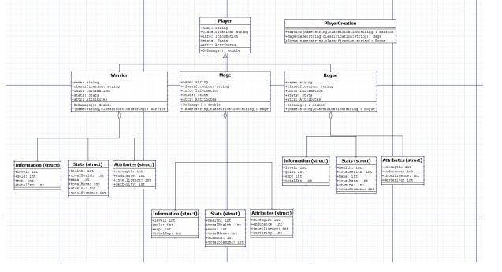
Class Diagrams

Slide 5
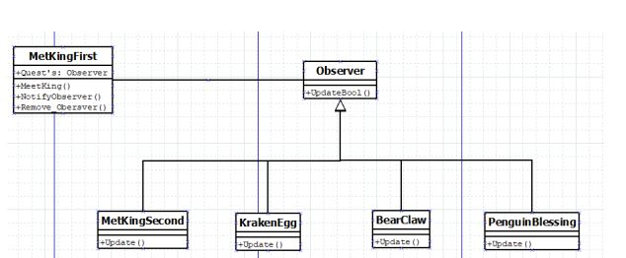
Class Diagrams

Slide 6
DEMO

Slide 7
Future Work
Add more sounds/Background music
Add more maps( such as reading in from files/Randomly generated)
Add stories to set maps

Slide 8
Contact
Github: https://github.com/hunlreev/Text-Adventure-RPG
Email: hunlreev@ut.utm.edu
Email: bilwgibs@ut.utm.edu

